Slide 1
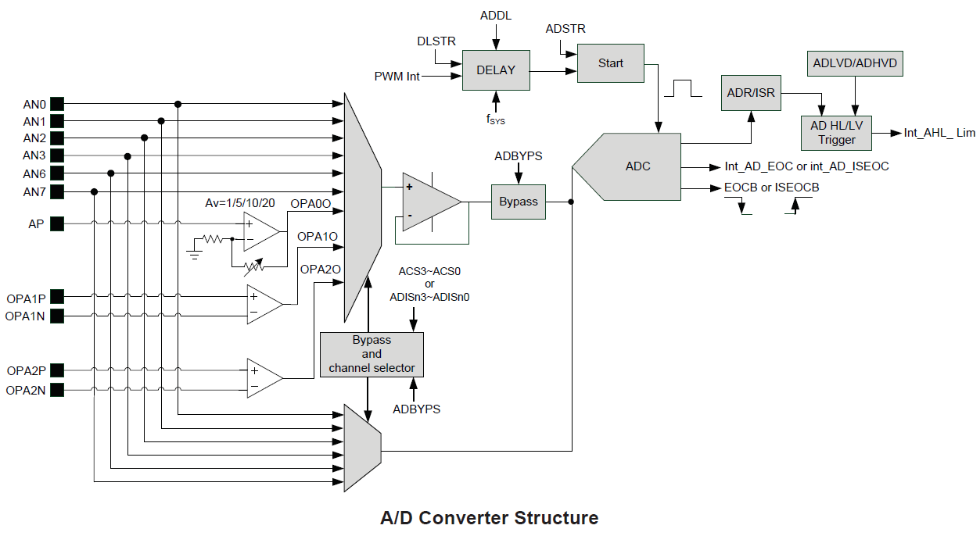
ADCRL_SEL (ADCR2[6]): 12/10 bit
UGB_ON(ADBYPS[7]: buffer on
ADSTR(ADCR0[7]): Start A/D Conversion
DLSTR(ADCR1[6]): A/D auto-scan conversion control

Slide 2
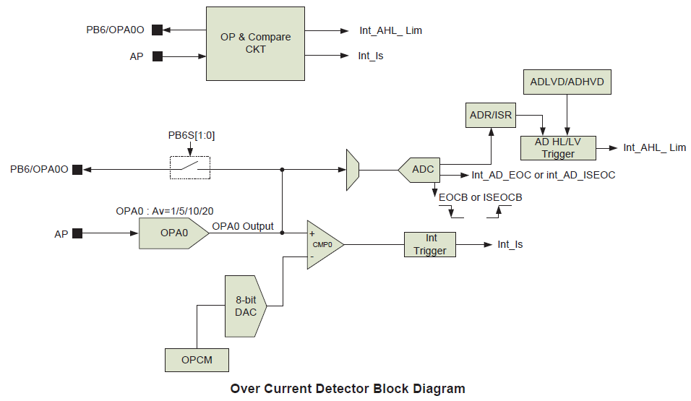

Slide 3
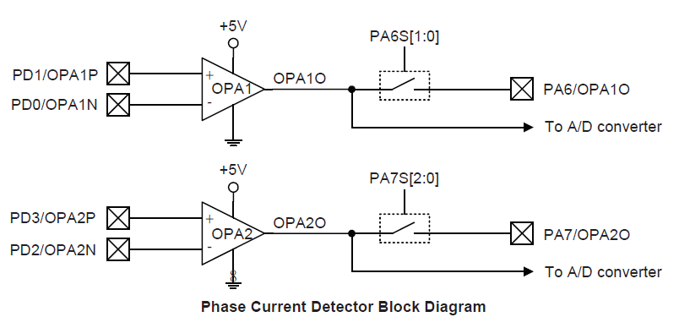

Slide 4
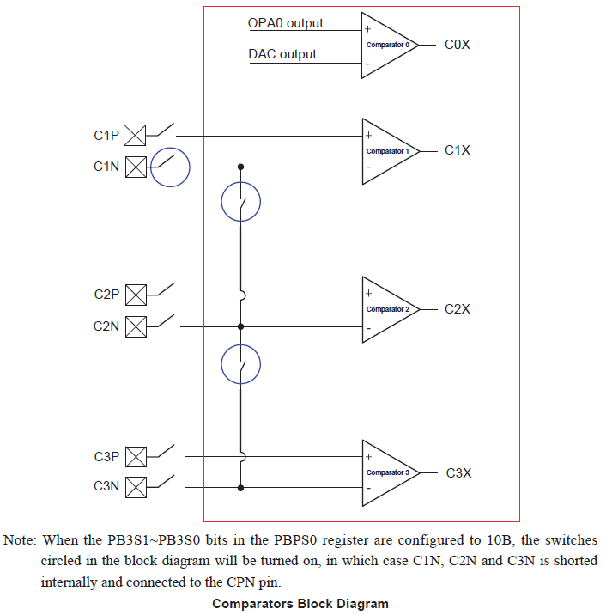

Slide 5
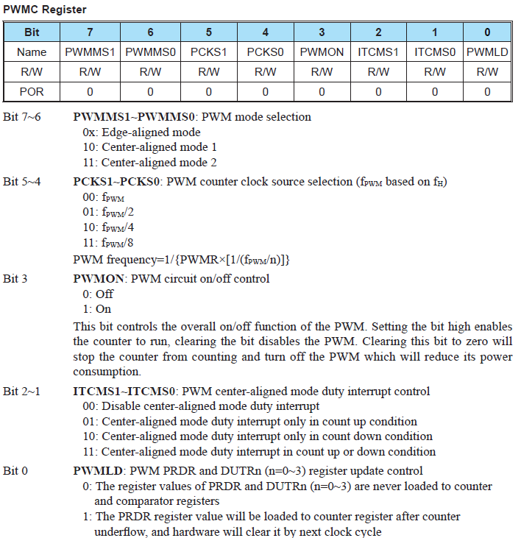
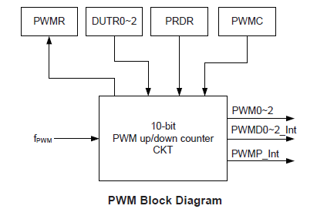

Slide 6
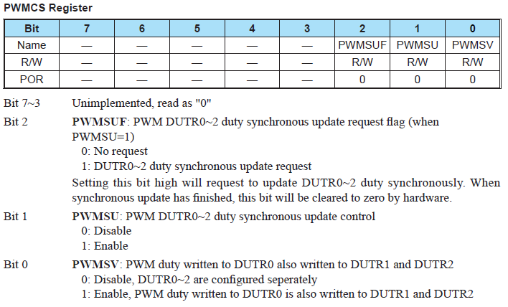

Slide 7
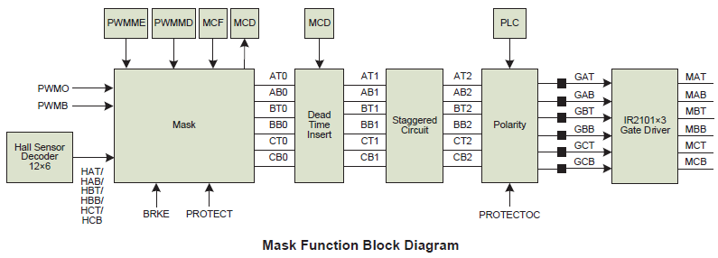
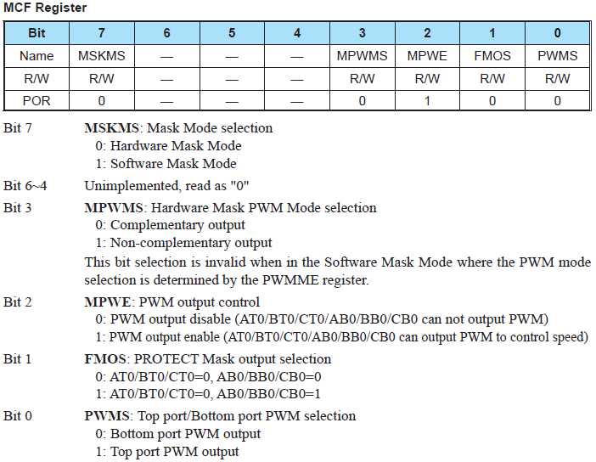
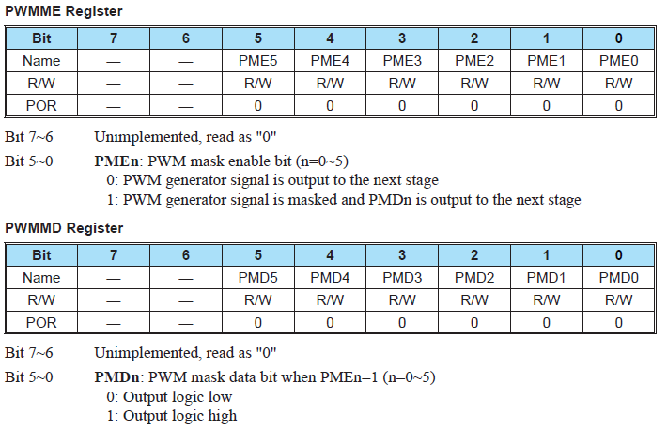
DTS

Slide 8
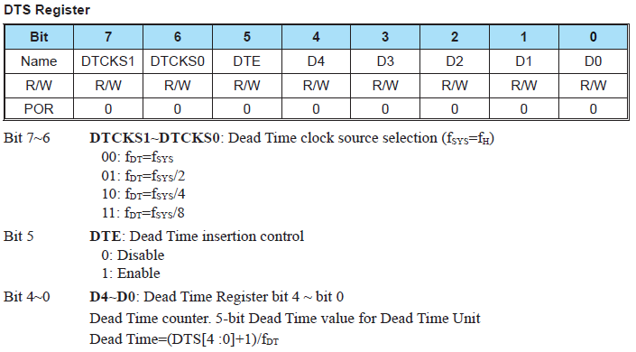
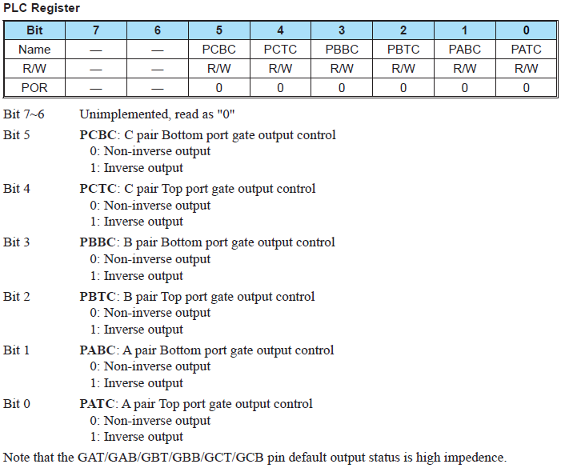

Slide 9
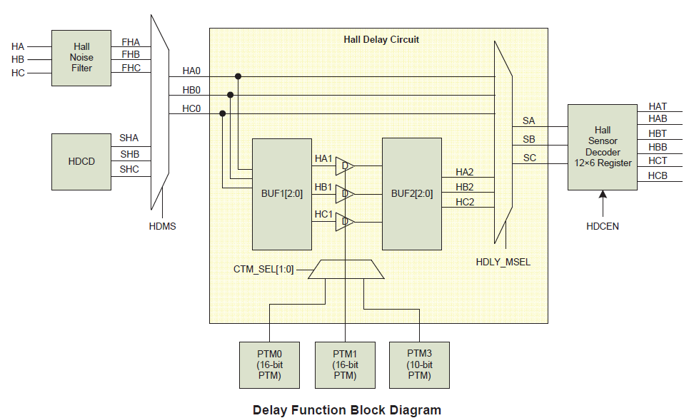
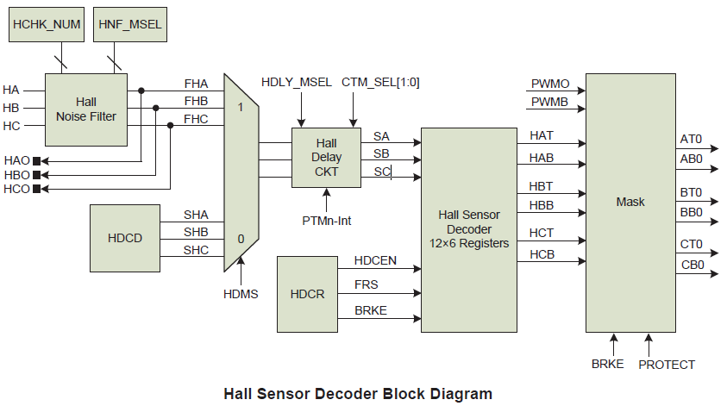
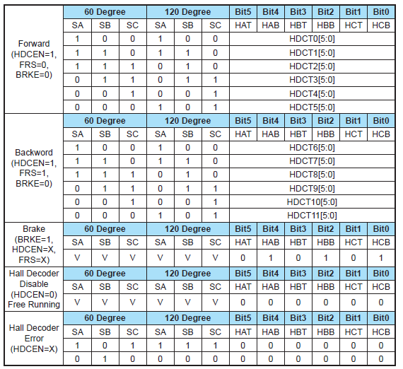
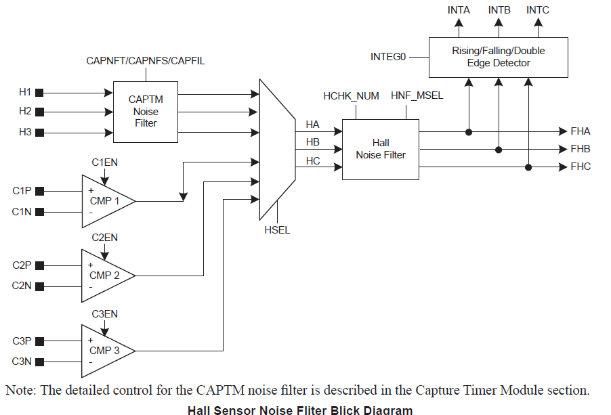

Slide 10
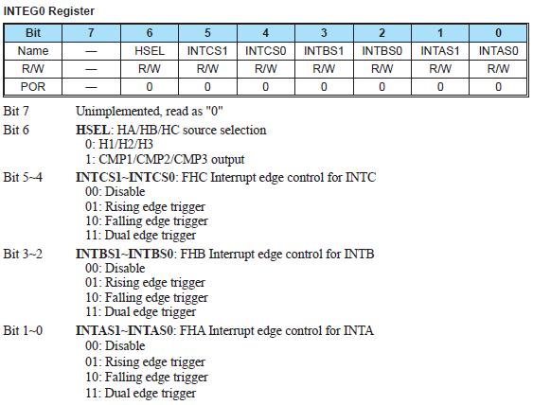
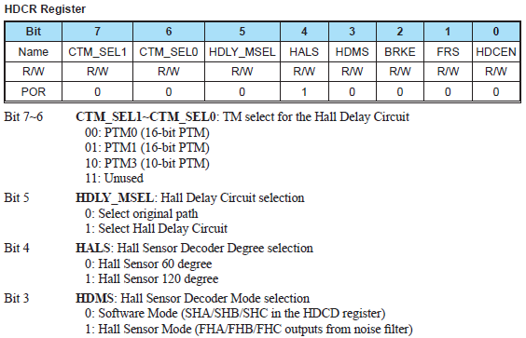
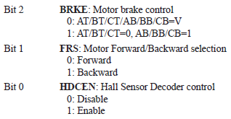

Slide 11
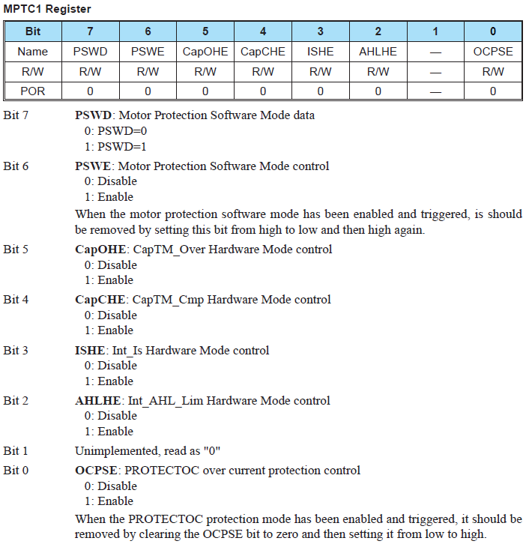
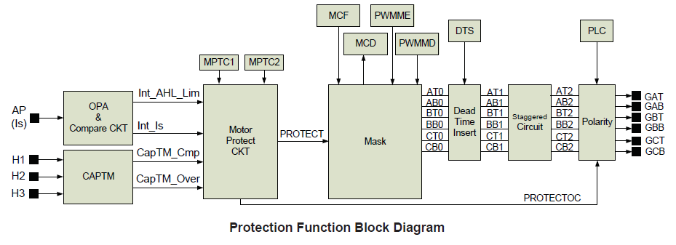
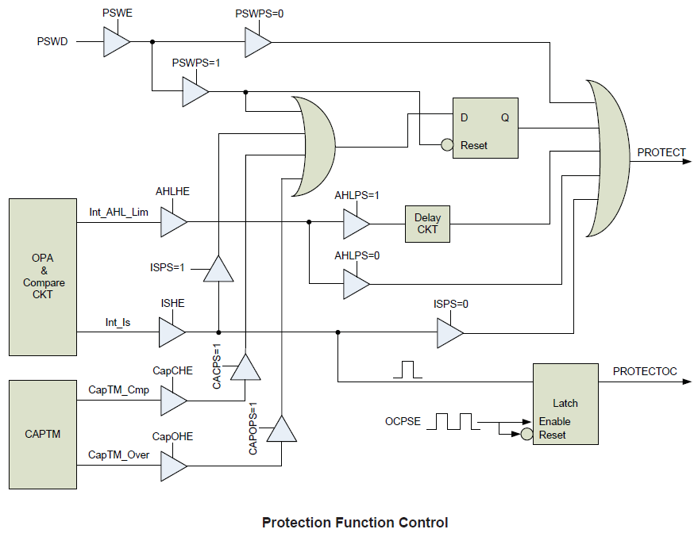
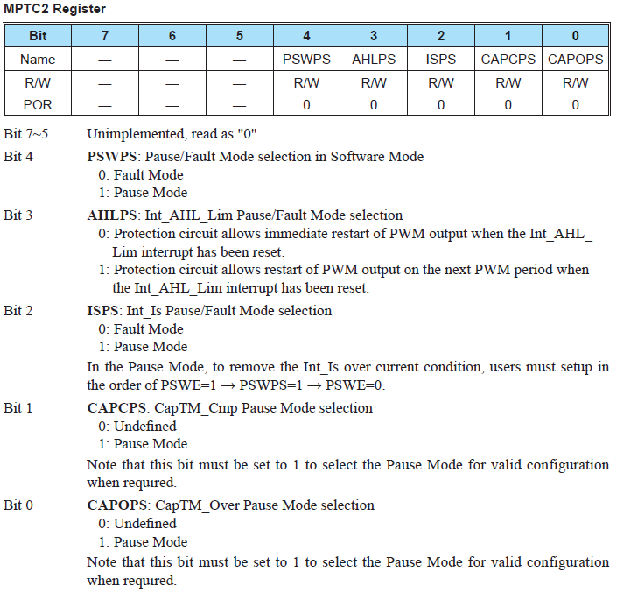

Slide 12
PWM_Initial
PWMC <- 00000001
Edge aligned, fpwm, pwm off, disable interrupt, PRDR underflow update
PWMC S <- 00000000
DTUR no update request, enable update, configured seperately
DUTRx <- 00000000
PRDR<- 0x0100
PWMON<- 1
MCF <- 00001101
Hardware mask, non-complementary output, PWM output enable,
AT0/BT0/CT0=0, AB0/BB0/CB0=0, Top port PWM output
DTS <- 01101001
Dead time enable, Fdt = 0.5*fsys , deat time=0b1001
PLC <- 00000000
Non inverse output
INTEG0 <- 00000000
Input: H/H2/H3, disable interrupt
HDCR<- 11011011
PTM unused, orgional path, 120 degree, hall mode, not brake, backward , decoder enable
HDCT0~11
Hall sensor decoder
MPTC1<- 00101000
CapTM_Over enable, enable Int_Is
MPTC2<- 00000101
Fault mode, Int_AHL_Lim Immediately restart, Int_Is/CapTM_Over Pause mode
OCPS<- 00000000
gate signal will output low on protection

Slide 13
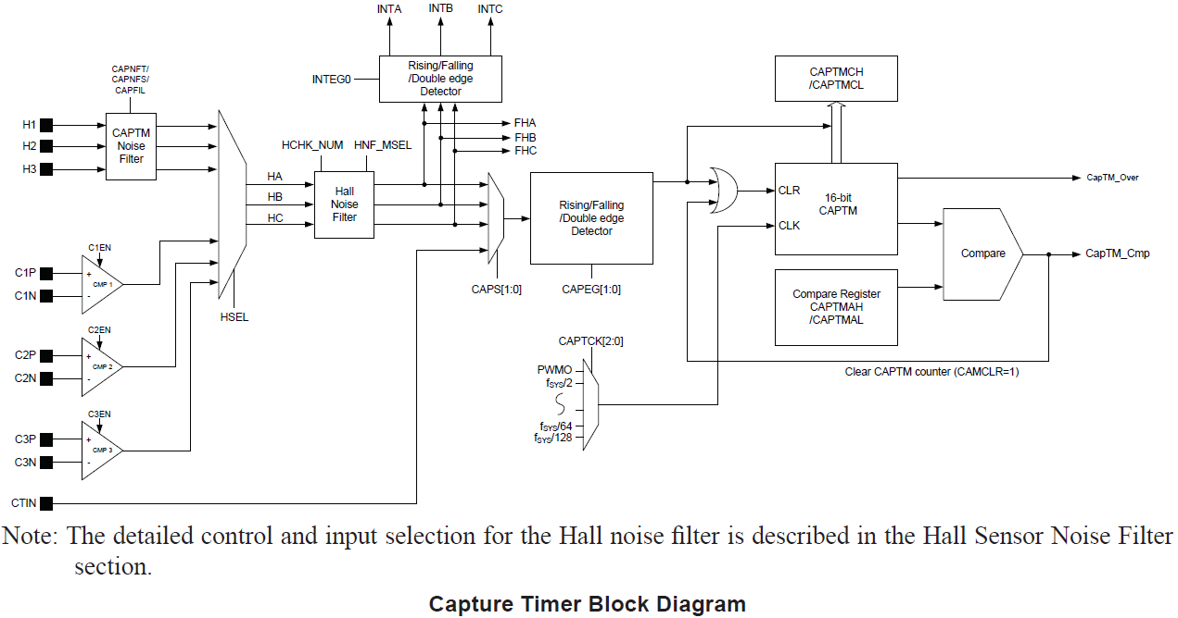
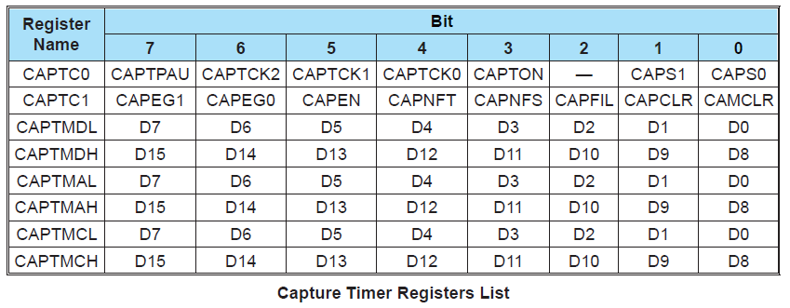
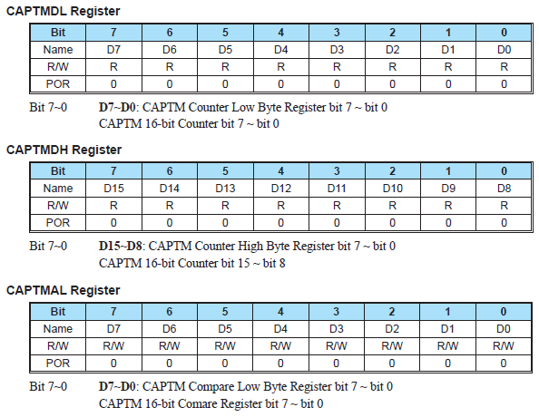
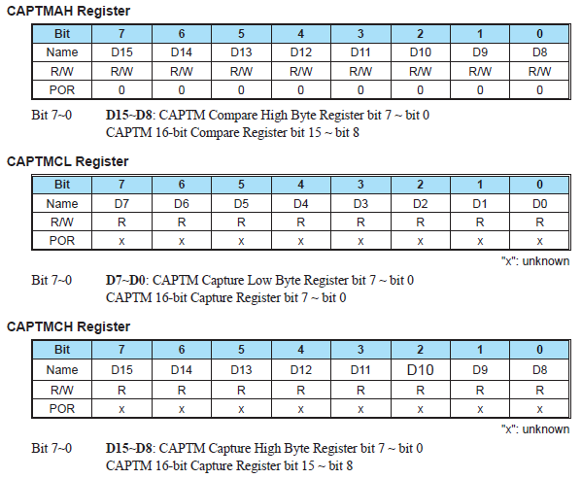

Slide 14
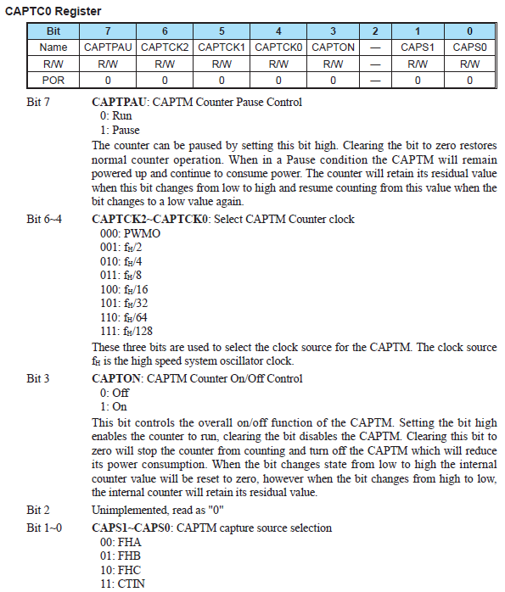
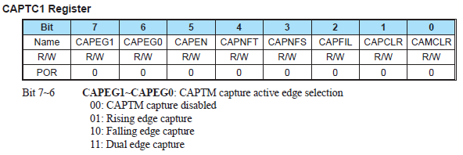
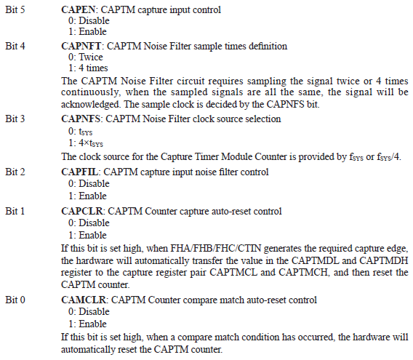

Slide 15
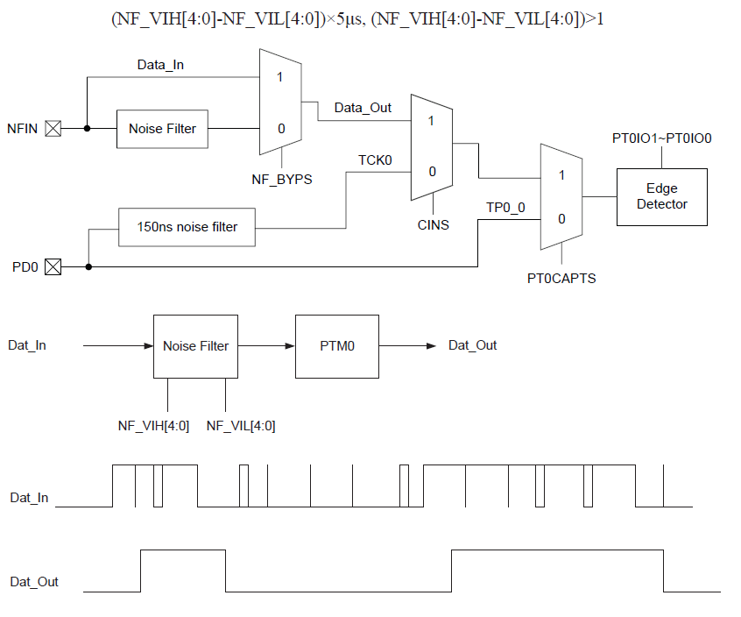
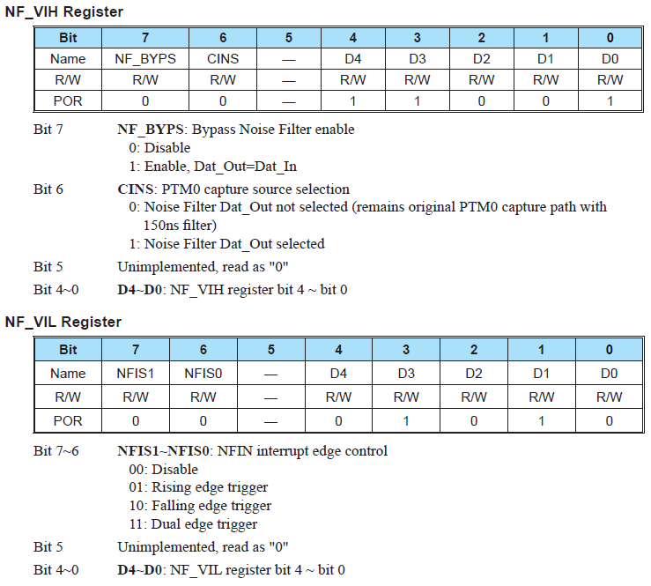
Noise Filter

Slide 16
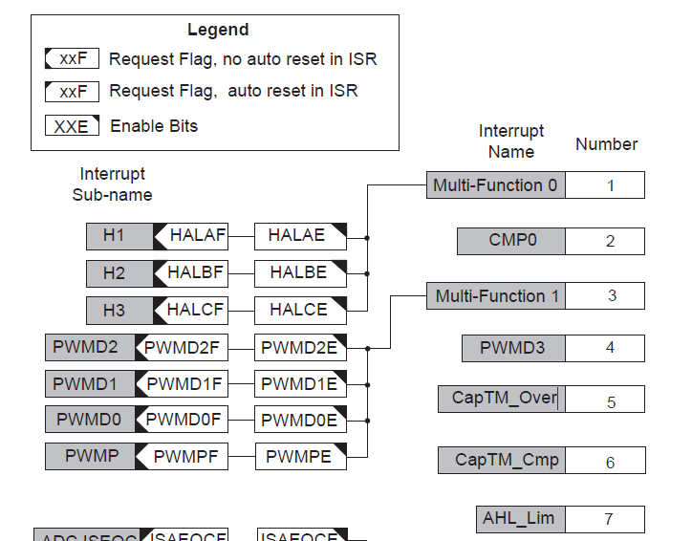
CAPTM_Initial
CAPTC0 <- 0111 0000
fh/128, source FHA
CAPTC1 <- 0111 0010
Rising edge, sampling 4 time, clock source = tsys, input noise filter disable, auto-reset, disable compare reset
CAPTMA <- 0xF424
Compare register
CAPTON <- 1
Counter on
Int_Pri5E <- 1
Enable CapTM_Over interrupt

Slide 17
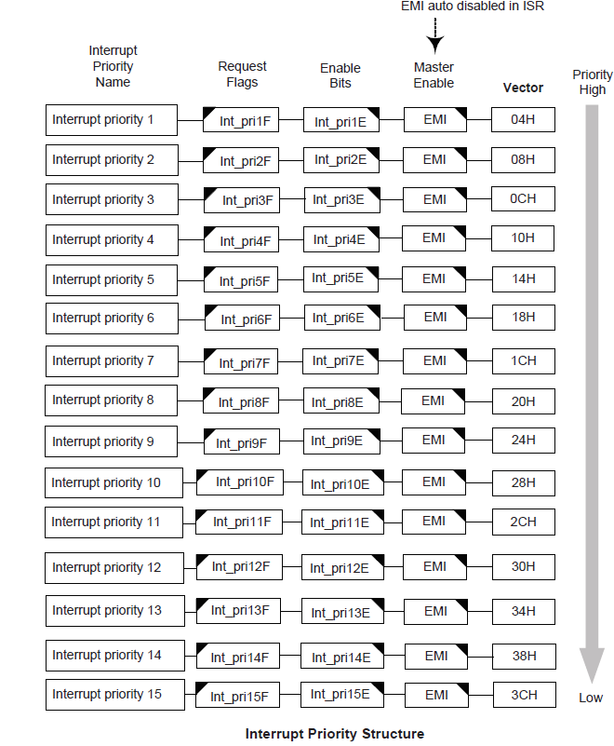
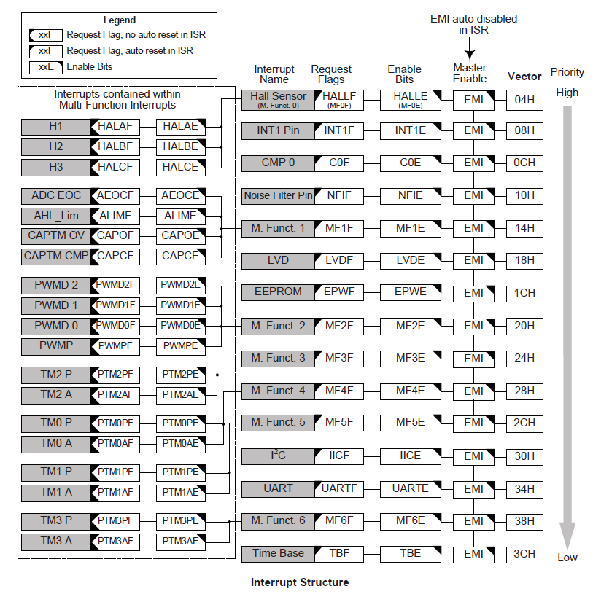
HT5440
HT5240

Slide 18
